Slide 1
Jupyter notebook: on PC, part 1
We shall focus on using Jupyter Notebooks for Python.
This assumes you have either installed Python on your PC, or you are utilizing a site such as Google Colab.
If running Python locally on your PC, you would type: jupyter notebook [command in a terminal window]
You would then see a number of lines of text appear.
See an example of this on the next slide.
Why Jupyter? For 3 languages – Julia, Python and R.

Slide 2
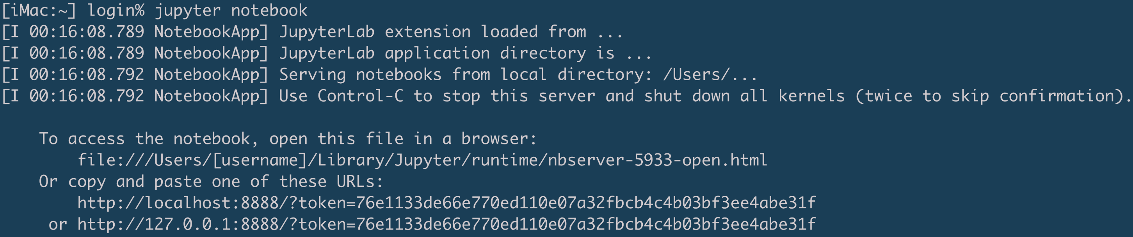
Jupyter notebook: on PC, part 2
The text output from running jupyter notebook could be:
You may not need to open a file or copy/paste a URL. The Jupyter notebook should simply open up in your browser.
Here is how you kill the Jupyter server that was just started: Hold Control, and type C (twice).
These instructions tell you how to open / view the Jupyter notebook.
Notes:
Session results from snapshot by Brian Jewett.

Slide 3
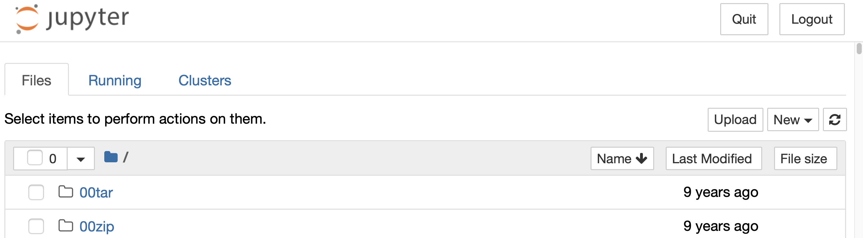
Jupyter notebook: on PC, part 3
Here is a PC-local Jupyter notebook window:
Only one more step needed: Click on the New menu button, and select Python 3 to open an empty Jupyter Notebook window.
If you began jupyter notebook from a local PC folder containing files, you will see them here.
Notes:
Session results from snapshot by Brian Jewett.

Slide 4
Jupyter notebook: on Google Colab
If using Google Colab, here are the steps to begin:
Open this URL: colab.research.google.com
Sign in to Google, if you have not yet done so.
If you get a window with an orange menu bar:
click on NEW NOTEBOOK at the bottom-right corner.
If you instead see the Welcome to Colaboratory page, find the File menu under that Welcome text, and click to select File > New Notebook.

Slide 5
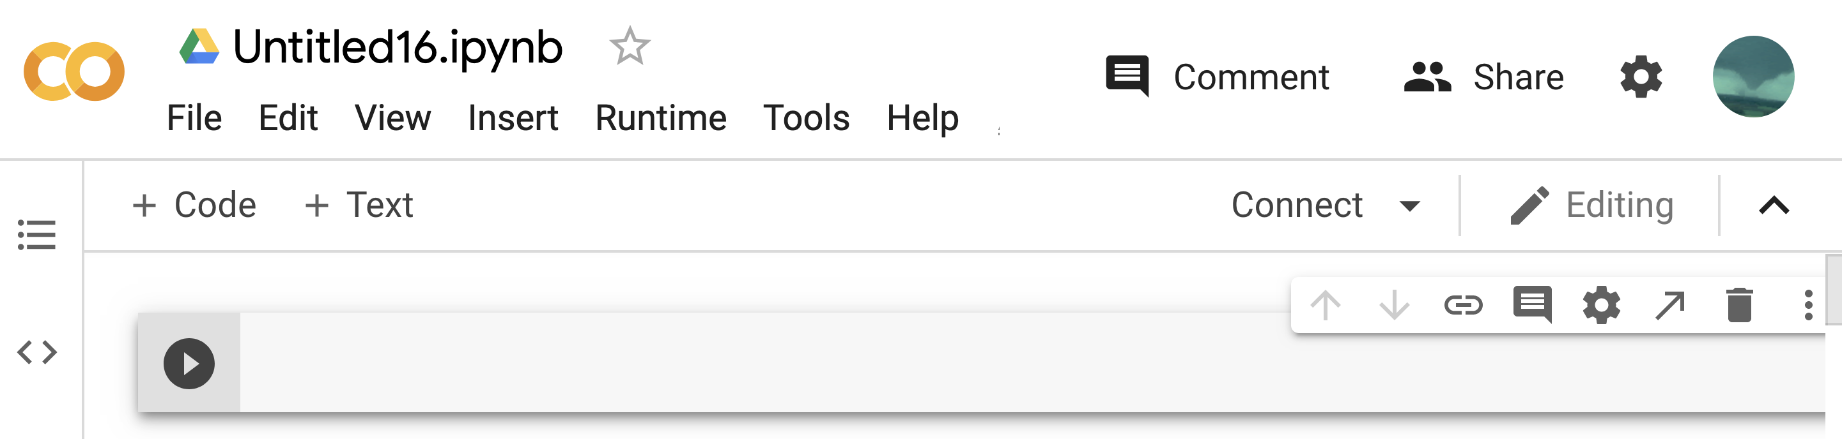
Jupyter notebook: Google Colab
And - here is a new Colab Jupyter notebook window:
If you were running Jupyter locally on your PC, you would see something similar. Our code will go in the box above.
(Python code will be typed here!)
Notes:
Session results from snapshot by Brian Jewett.

